Slide 1

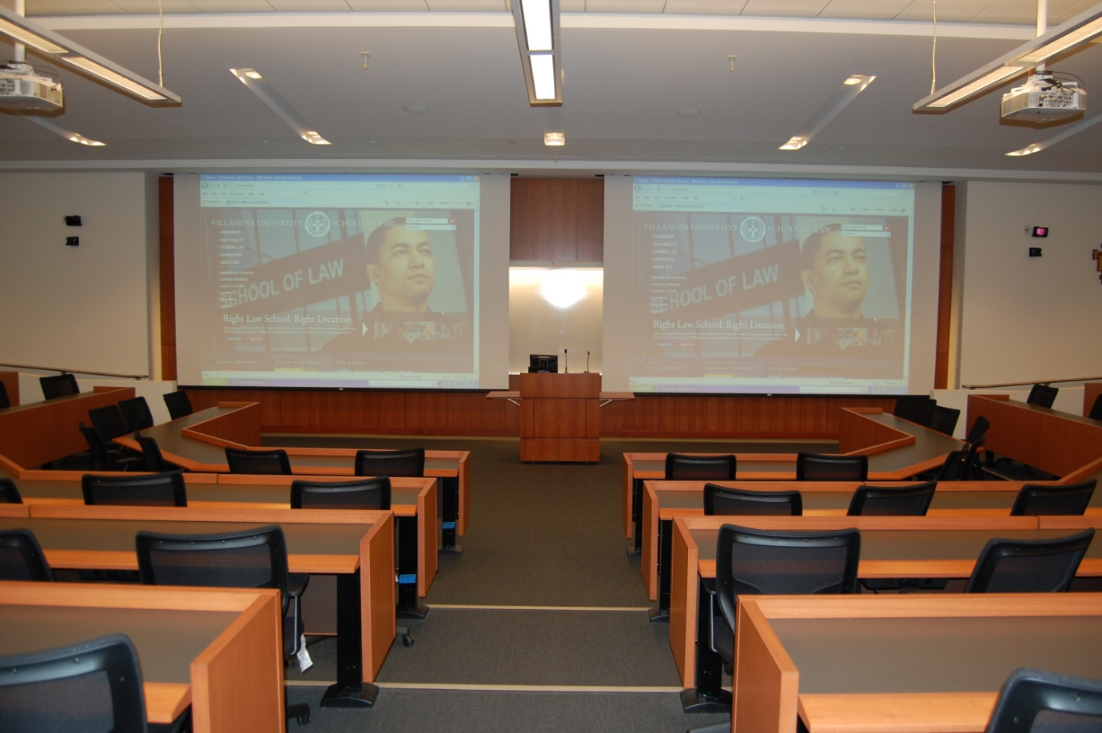
CALI
Design of Teaching Spaces
April Barton
Villanova University School of Law

Slide 2
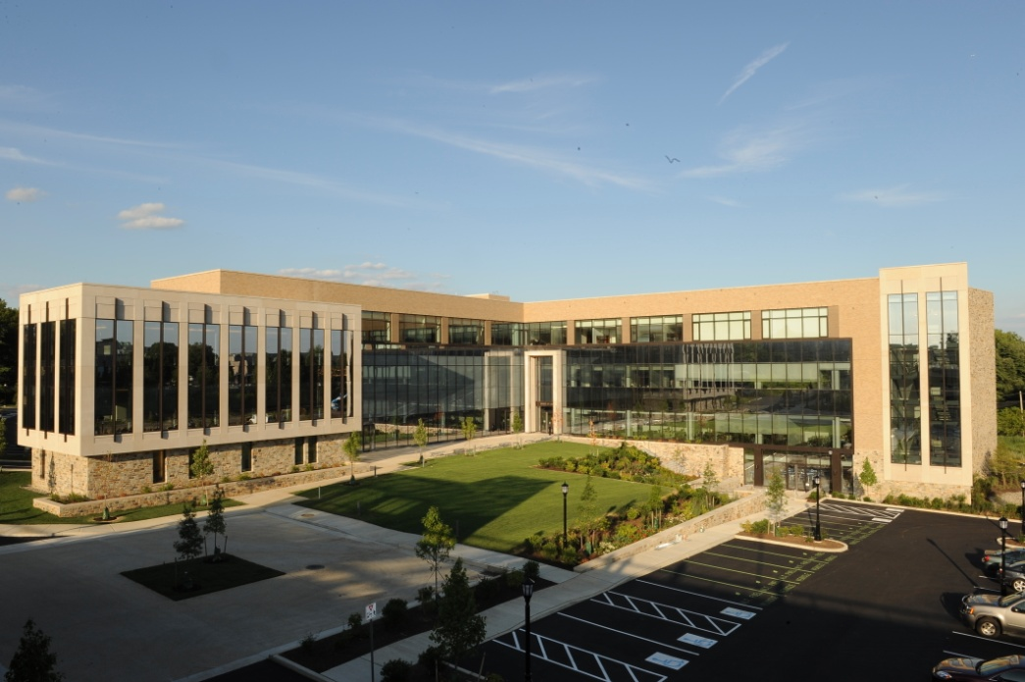
Overview
Preparation
AV Consultants
Reviewing Blueprints
Classroom Technology
  Lecterns
  Dual Projectors
Break out Rooms
Courtroom

Slide 3
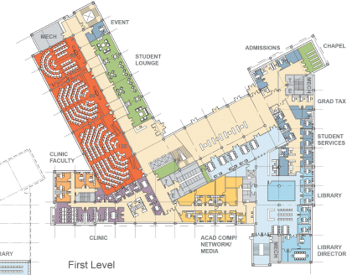
Getting Ready
Preparation

Slide 4
Preparation:
Form IT Committee
Committee that is representative of faculty, staff and students
Bullet Points with general concepts that guide entire project
Solidify your needs and expectations

Slide 5
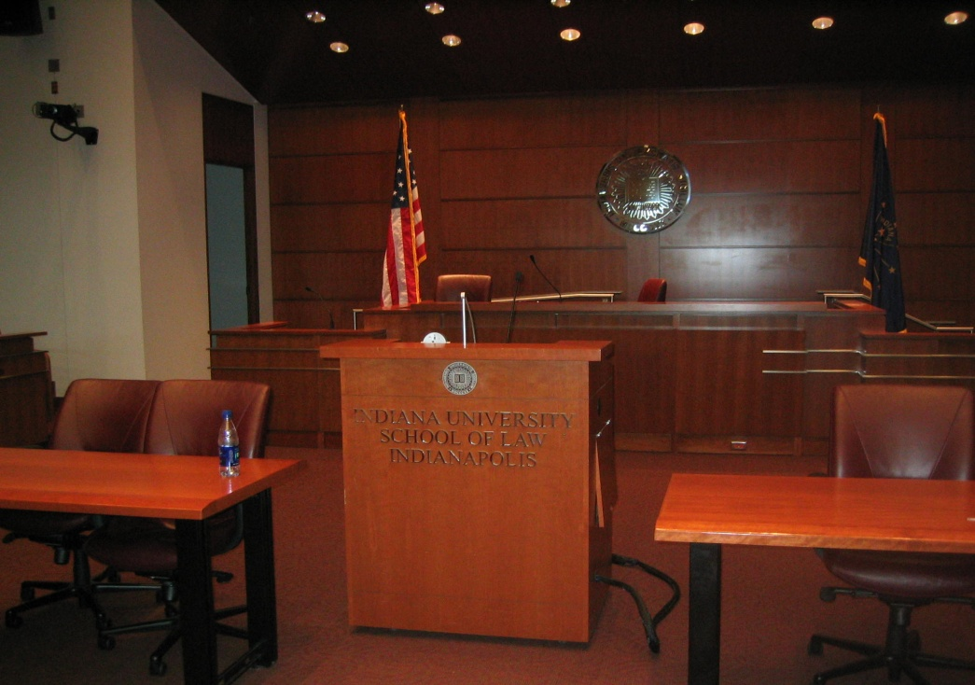
Preparation:
Visiting Other Schools
Take pictures
  Store in common directory for easy access
  Naming files
Ask: What would you have done differently?
  Helps avoid mistakes

Slide 6
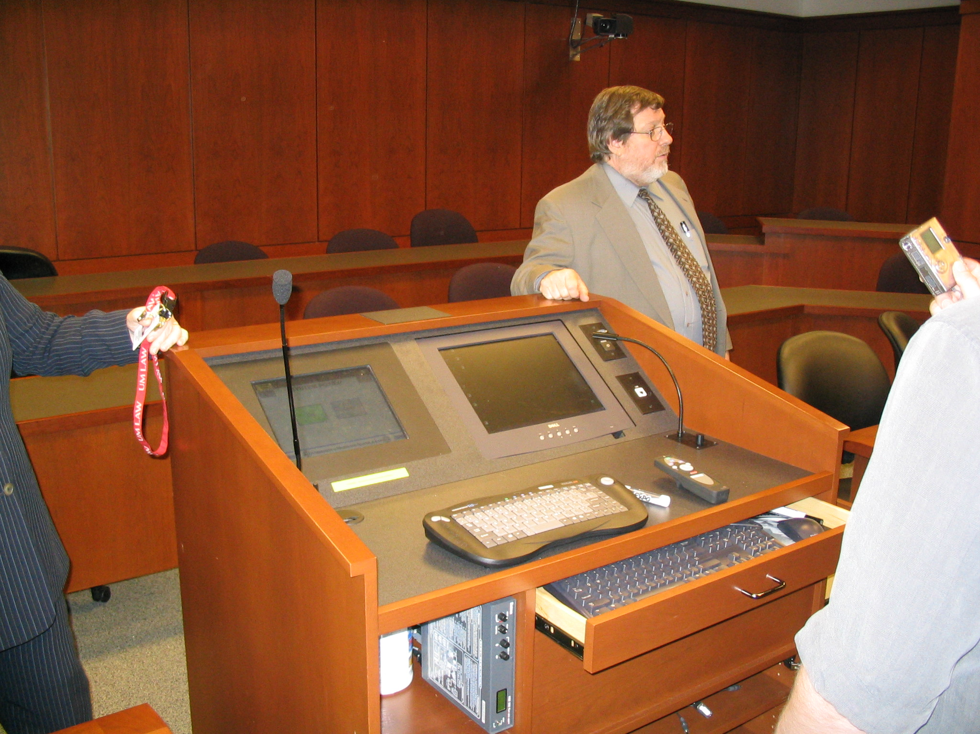
Preparation:
Pictures to Prompt Discussions

Slide 7
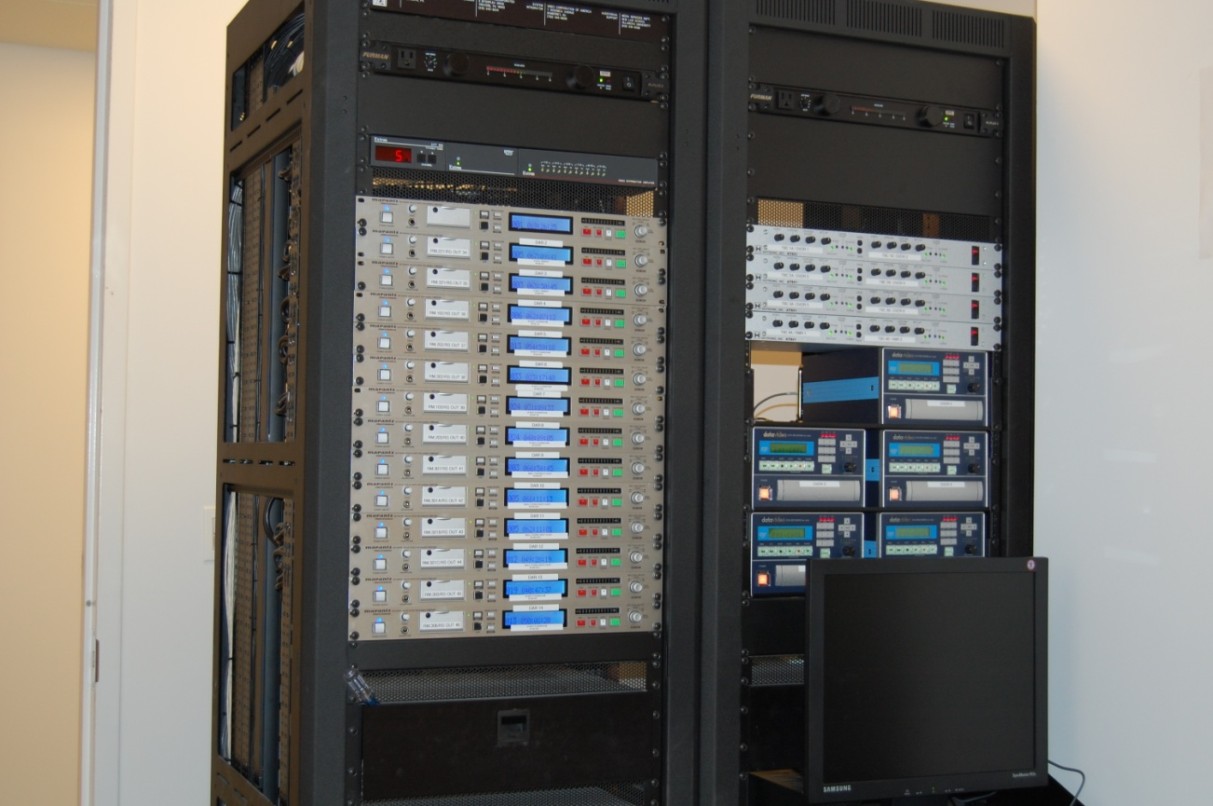
What are you looking for in AV firm?
AV Consultants

Slide 8
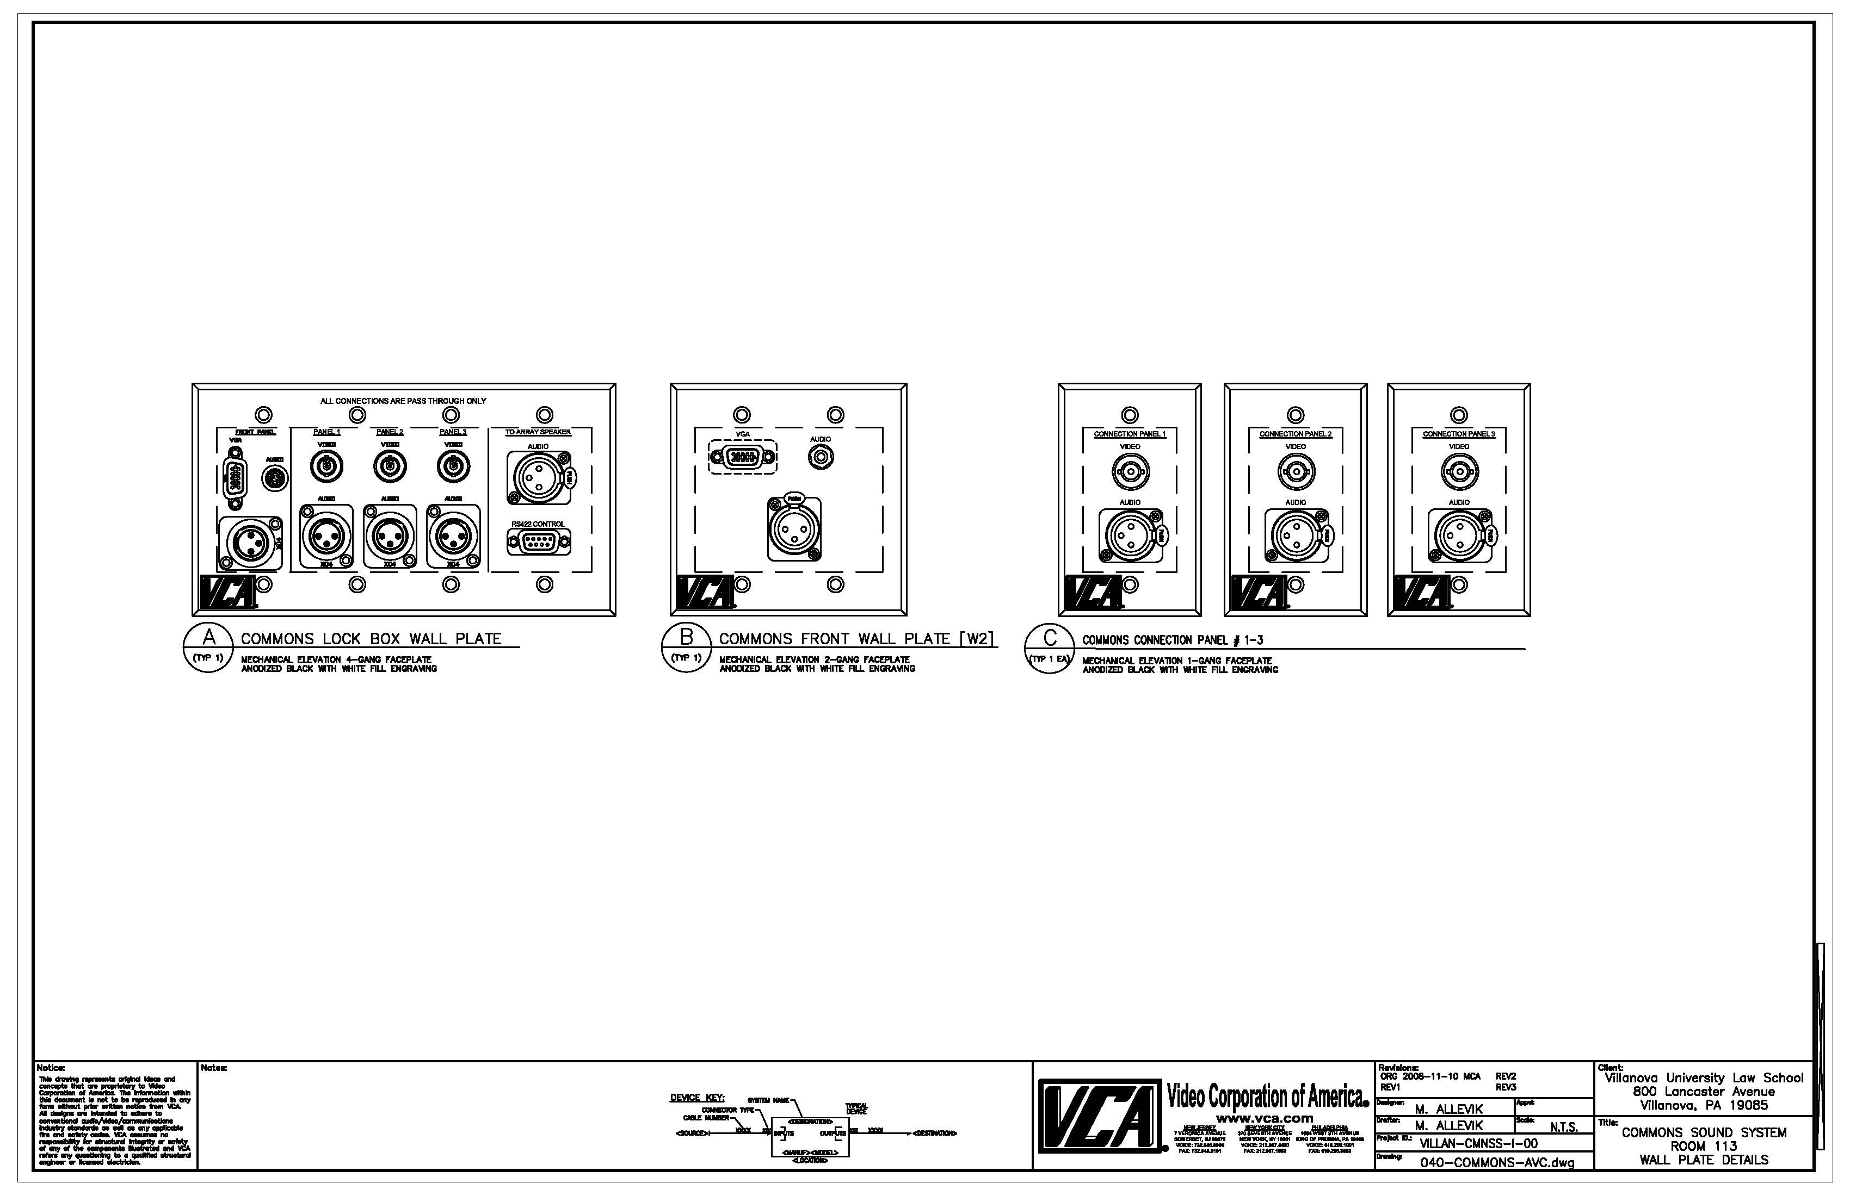
AV Consultants
AV consultants vs. integrators
Higher ed and law school experience
  Law school pedagogy vs. undergraduate or business school model
    Classroom teaching styles
    Courtrooms
    Clinical needs
Who is the client?

Slide 9
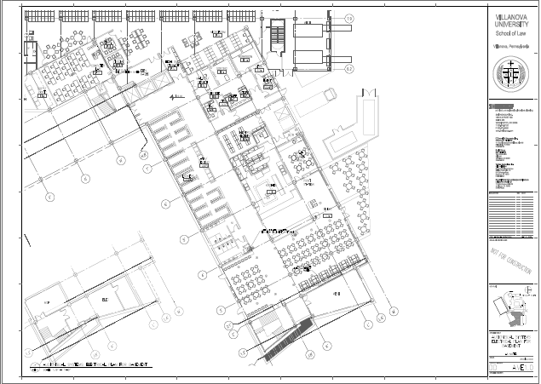
Reviewing Blueprints
Construction Drawings

Slide 10
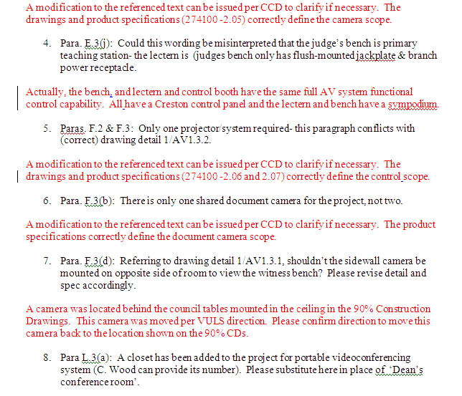
Reviewing Blueprints:
Constant Vigilance

Slide 11
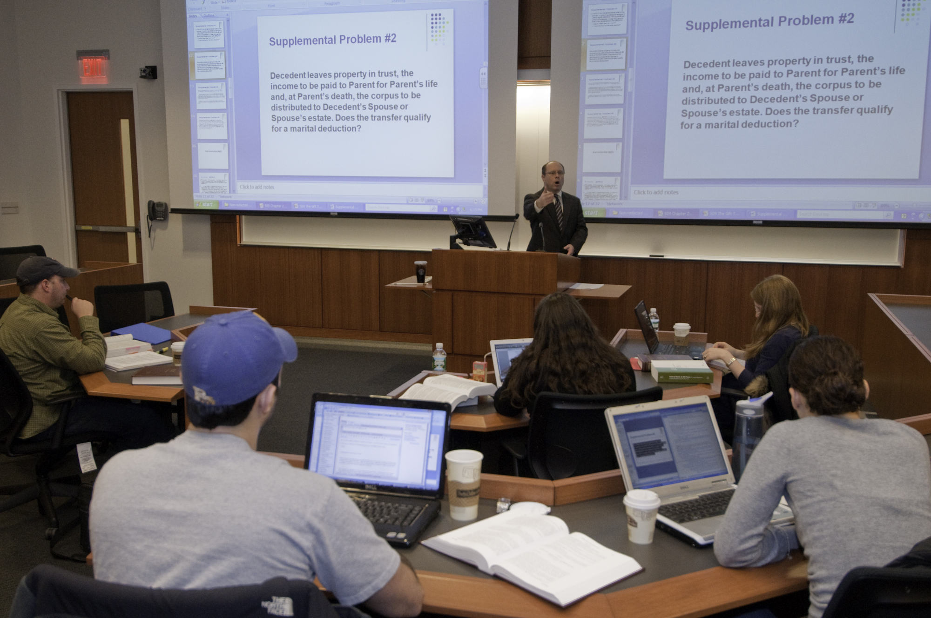
Lecterns
Classroom Technology

Slide 12
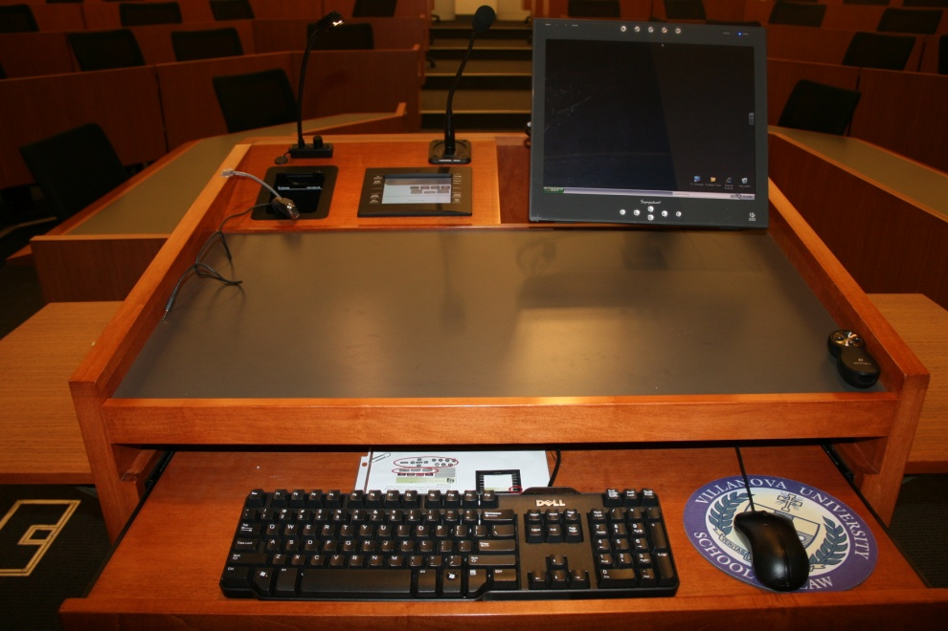
Lecterns
Most important technology feature of any classroom
Used everyday and must suit a wide range of needs
Must suit tech savvy –
technophobes

Slide 13
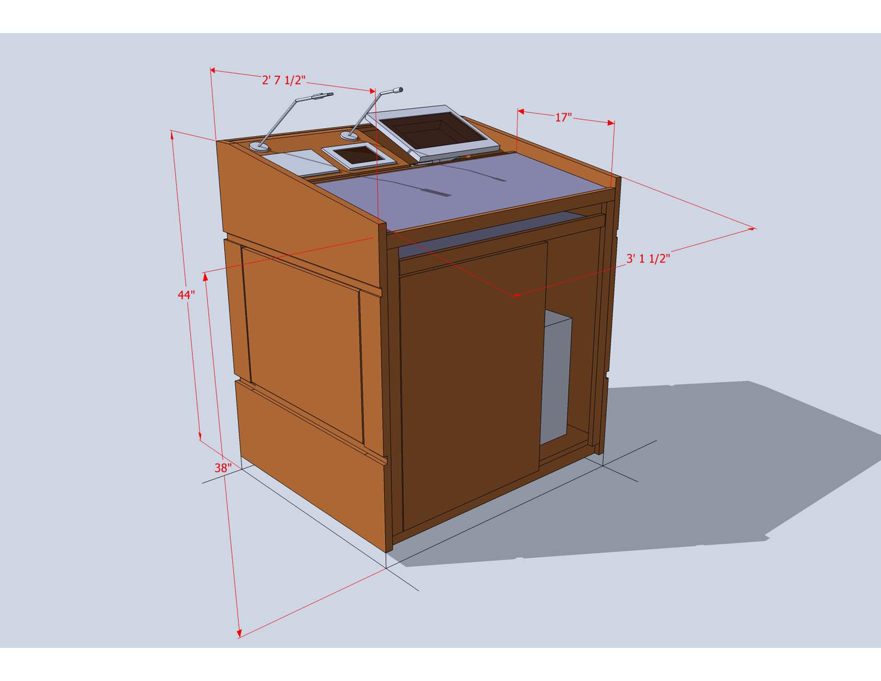
Lecterns: Size and Shape
Basic questions to ask your faculty
  How much surface area
  Slope?
  How big is too big/how
  small is too small
  Wings? Tables?

Slide 14
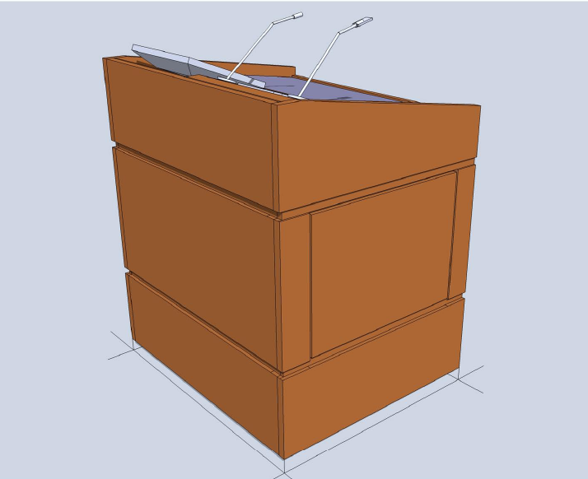
Lecterns: Height and Flexibility
Height
    Teacher side, student side
    Adjustable height
Moveable?

Slide 15
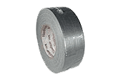
Lecterns:
Creating a Mock Up (or Two)
Cardboard and duct tape
Allowed faculty to stand behind life sized model of lectern
Significant changes were made
  Second model also built
  Greatly contributed to “buy in”

Slide 16
Lecterns:
Functions and Options

Slide 17
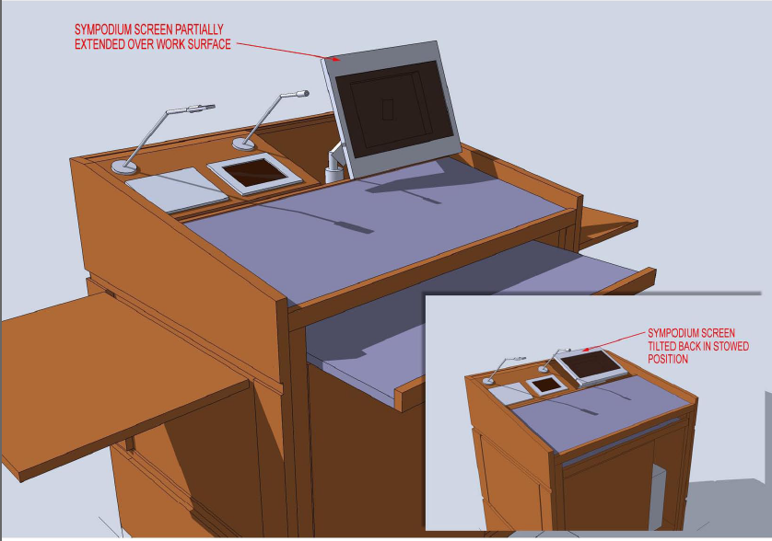
Lecterns: Fold Away Monitor

Slide 18
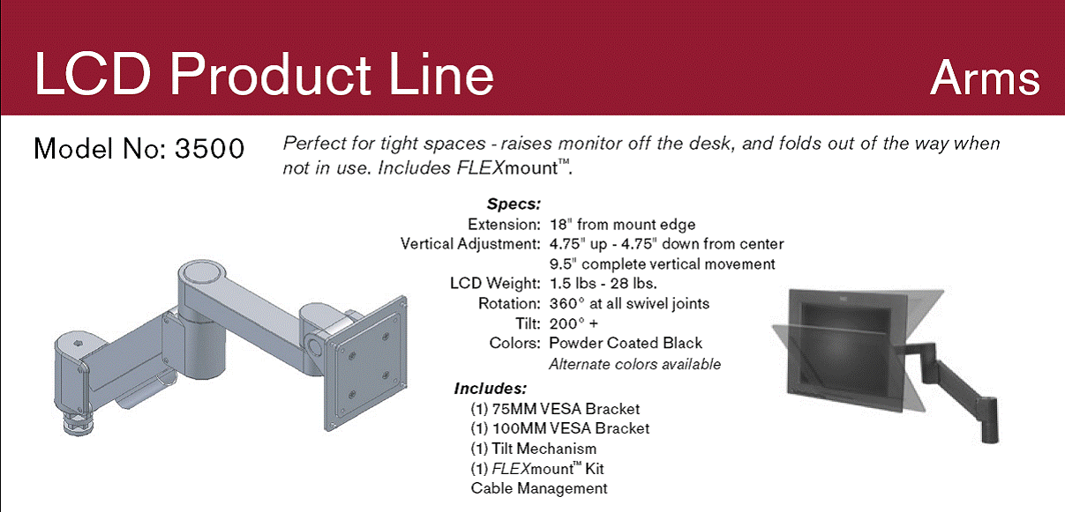
Lecterns: Articulating Arm

Slide 19
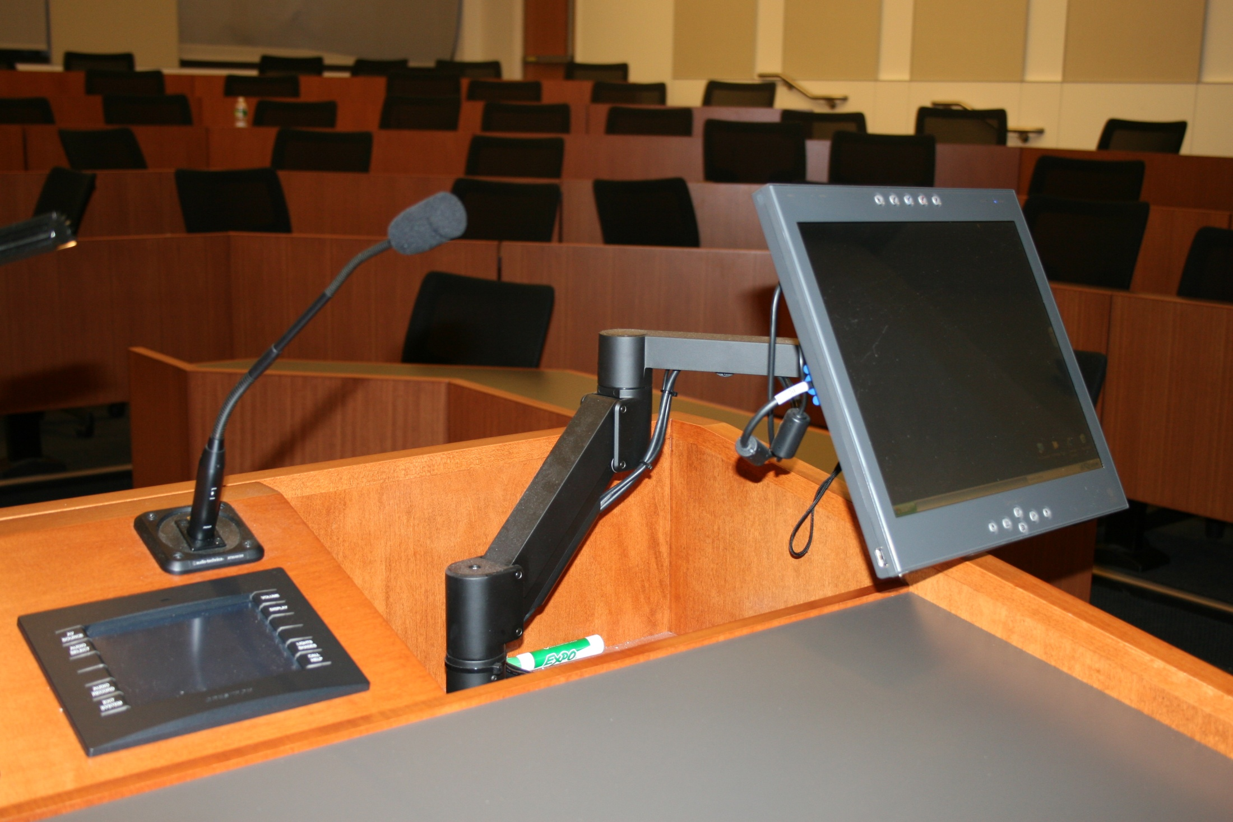
Lecterns: Articulating Arm

Slide 20
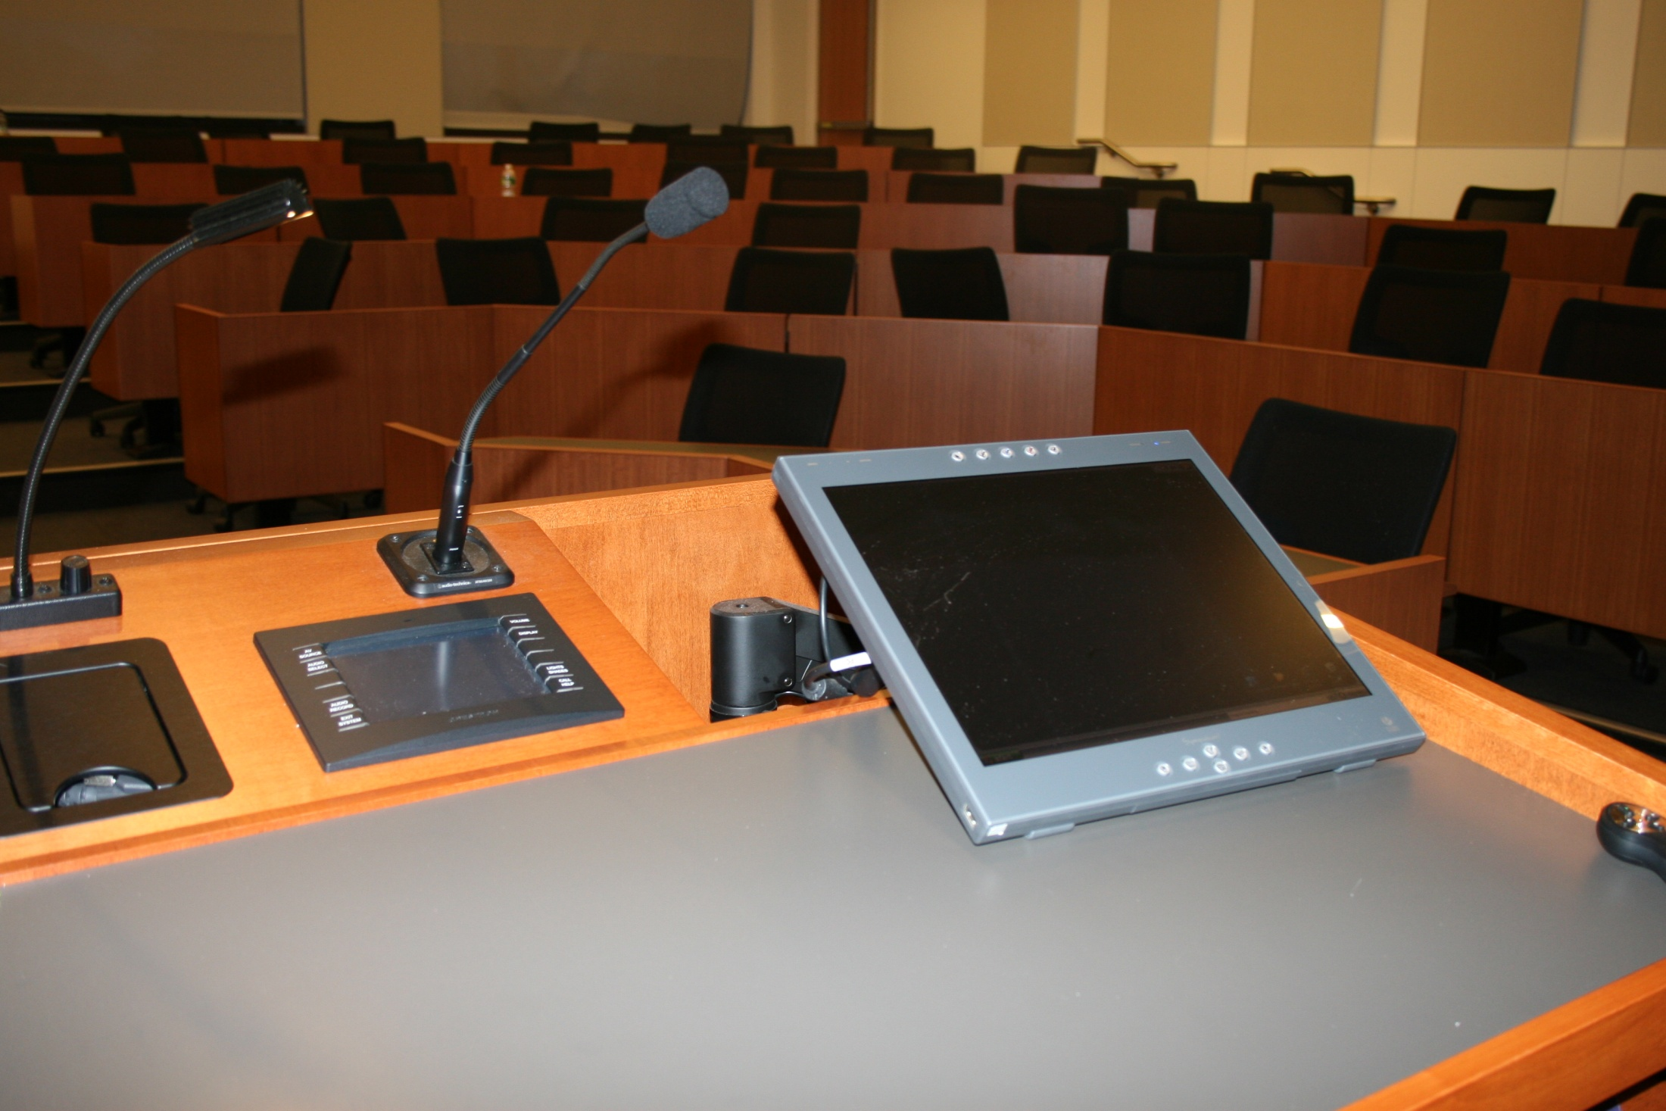
Lecterns: Articulating Arm

Slide 21
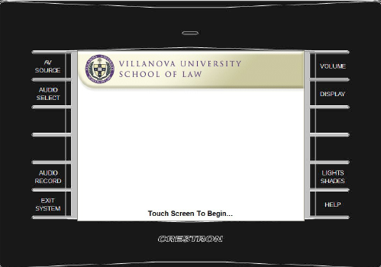
Lecterns: Touchpanel
To Build in or not?
  Cleaner appearance
  Maximizes space
  But standards change
Wall mounted wireless touchpanels
  May not find their way back to wall mount
  Connections get abused and broken

Slide 22
Lecterns: Touchpanels
Size Issue
  Larger (10” or 15”)
    More menu options on top level
    But takes up more real estate
  Smaller (6”)
    More “drilling”
    More thought into programming

Slide 23
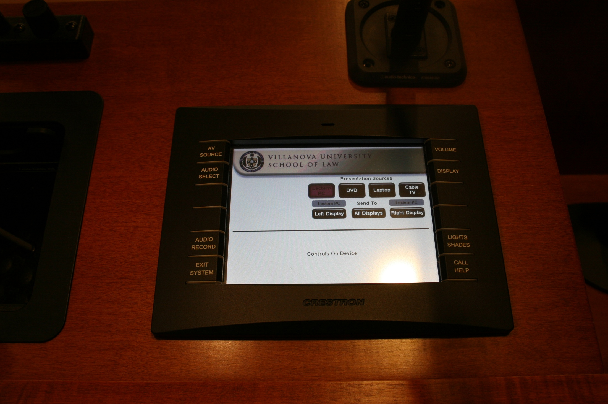
Lecterns: Touchpanels

Slide 24
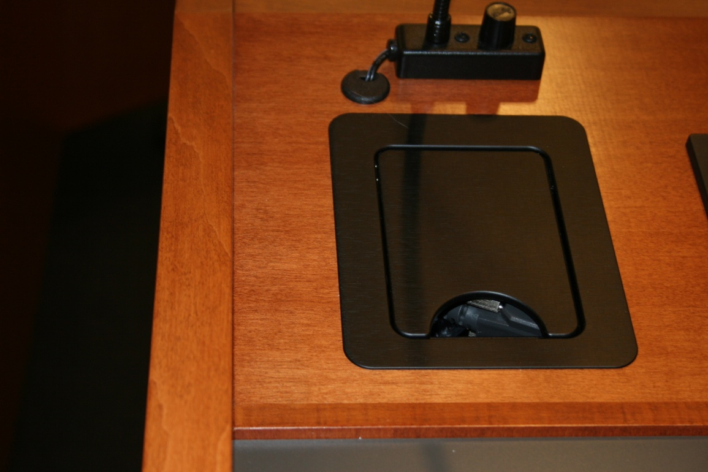
Lecterns: Cable Cubby

Slide 25
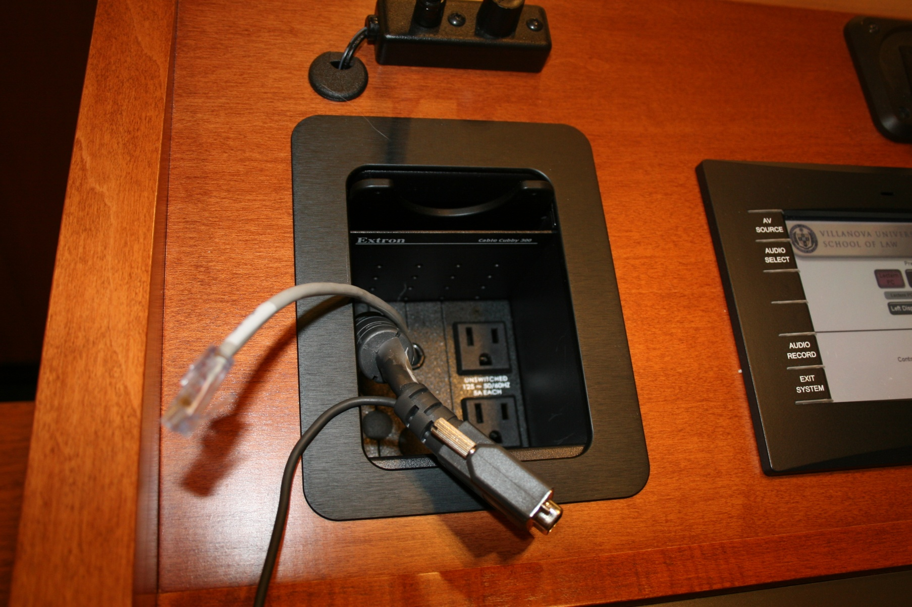
Lecterns: Cable Cubby

Slide 26
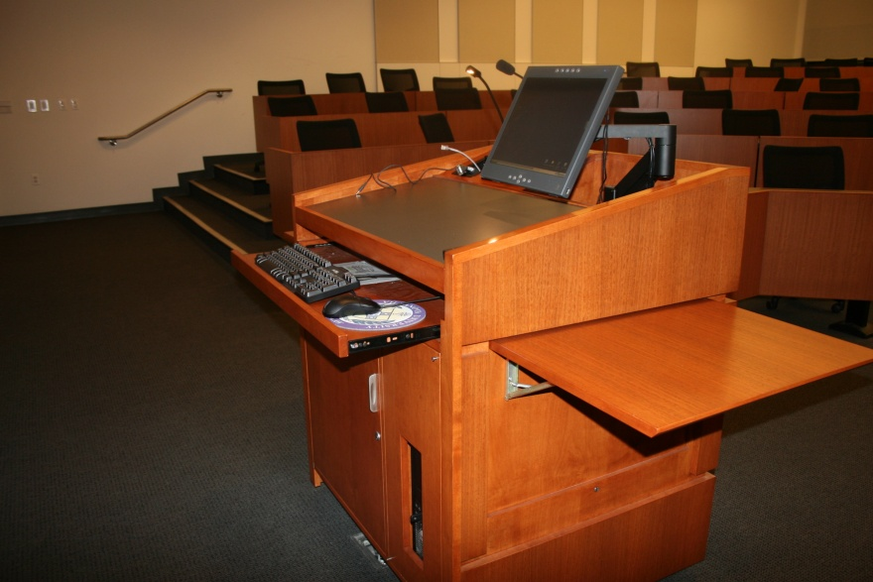
Villanova Lectern

Slide 27
Villanova Lectern

Slide 28
Dual Projectors
Classroom Technology

Slide 29
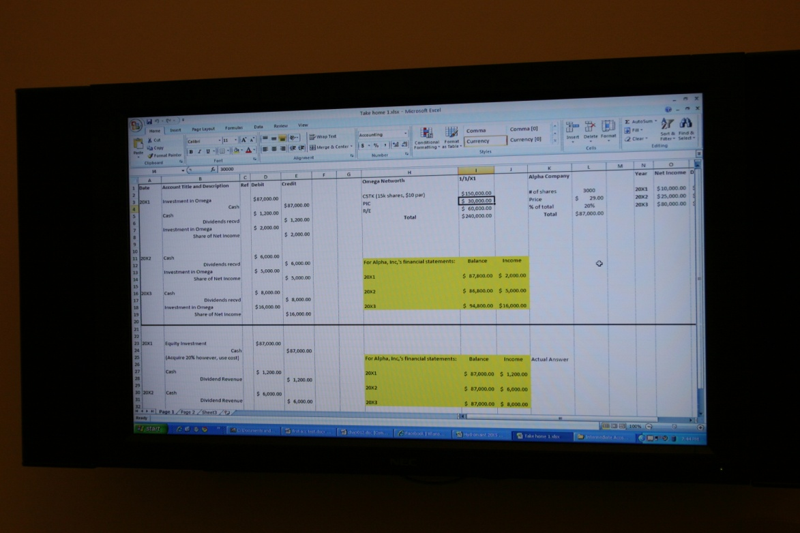
Breakout Rooms
Collaboration and Study Space

Slide 30
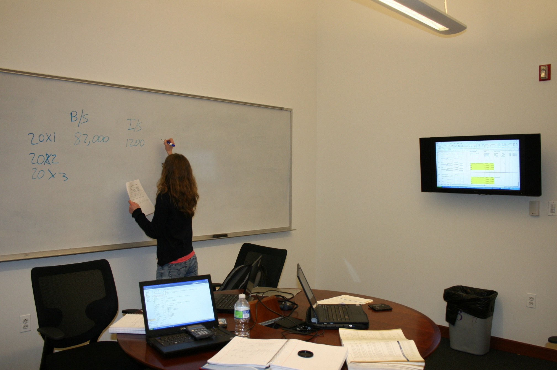
Collaboration/Breakout Rooms

Slide 31
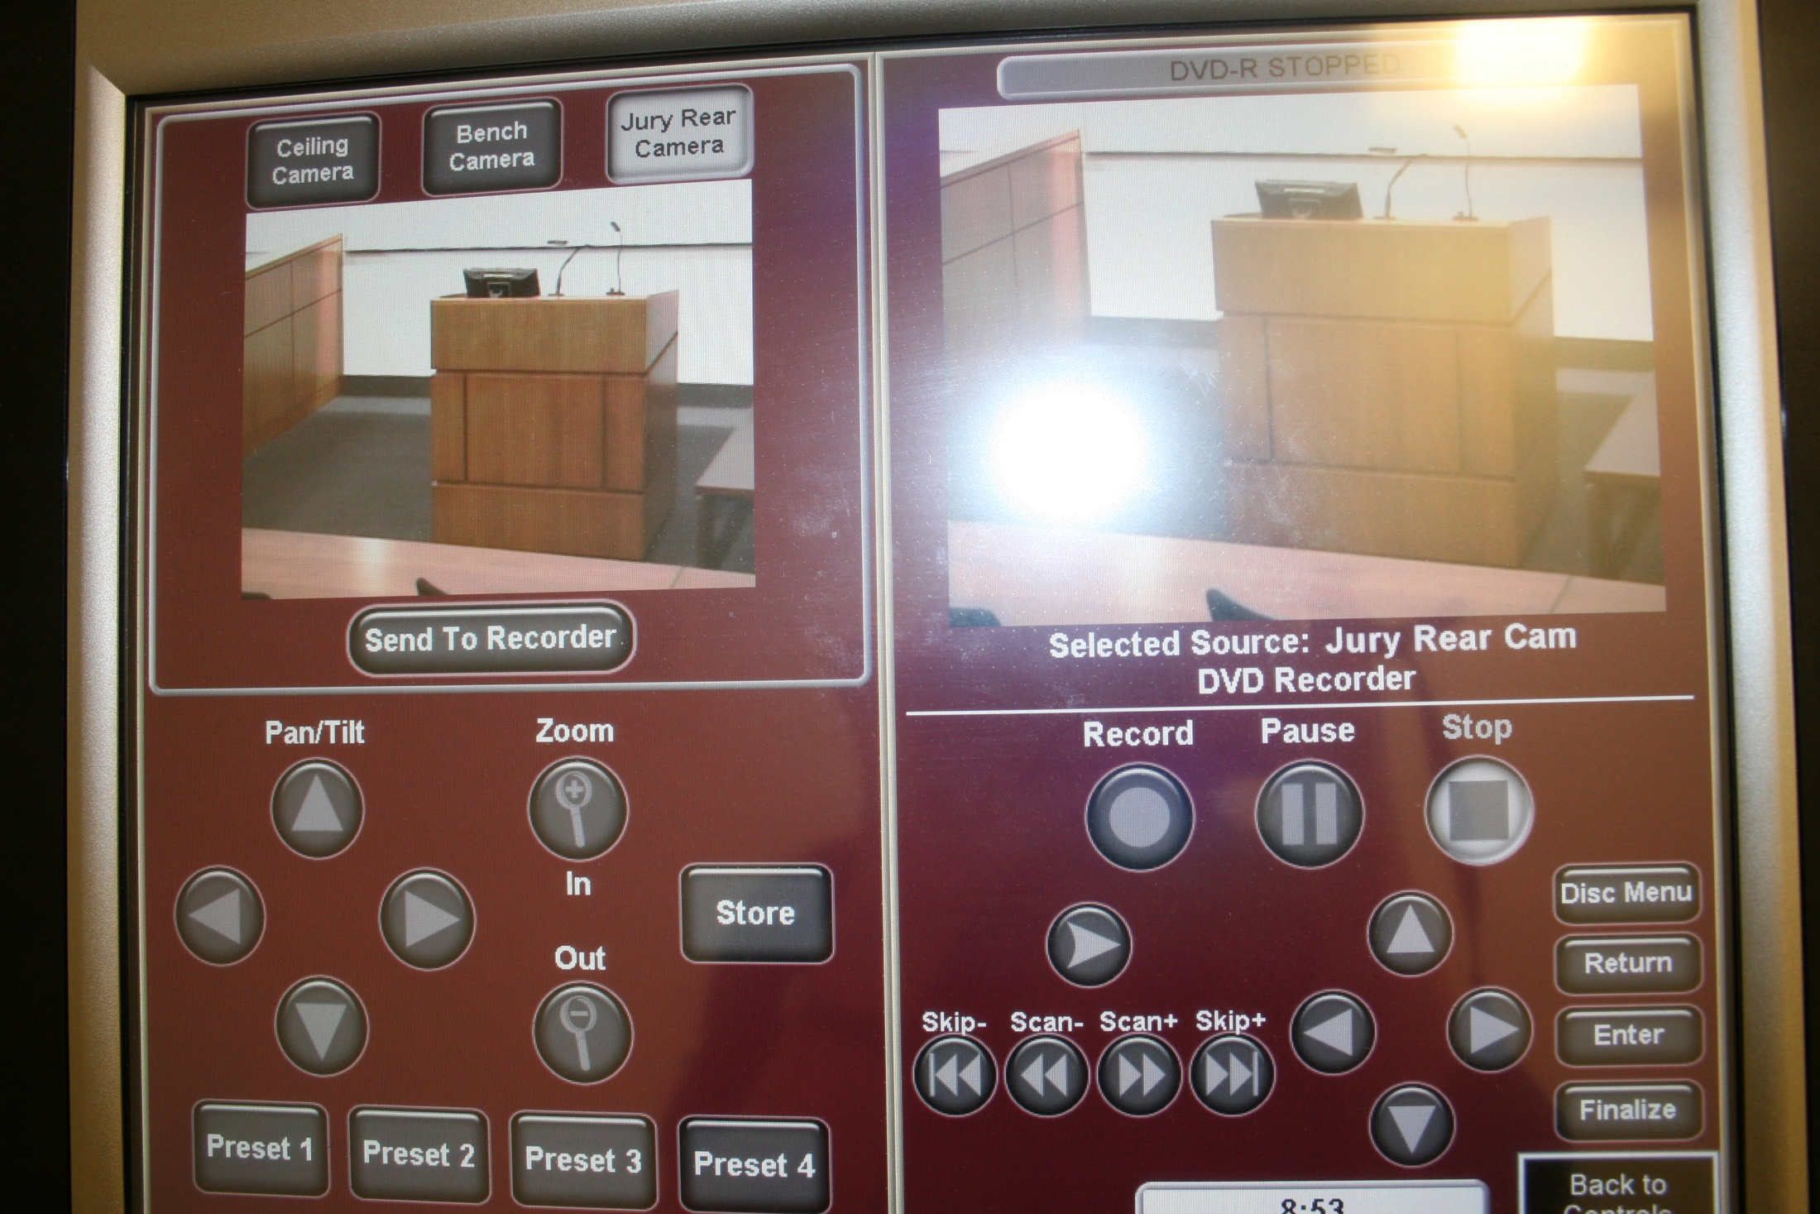

Slide 32
Conclusion
Time Consuming Process
Ask Questions, Review Carefully, Get it Right!

